Slide 1

Secure END to End Encryption Chat program “Enigma”
The Elder: Zheng Xu, Yue Qiao, BingXuan Ying

Slide 2
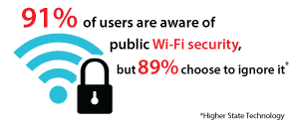

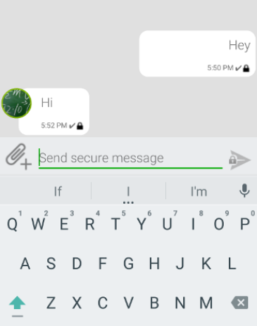
Security is a Big Problem in chatting!

Slide 3
Potential problems in this areas
1. Ethical reasons
2. Political reasons
Many…

Slide 4



Some apps you might know!

Slide 5

Some apps you Don’t know!
ENIGMA

Slide 6
Say hi to our “Enigma”!
Straight forward!
Encryption method we should all be familiar with. (AES, RSA)
3. No one knows your message!

Slide 7

Method We use To build our program

Slide 8


Slide 9
Conclusion
“Enigma” is best end-to-end encryption program we can make by far.
No adversary should be able to steal your message while using our app.
Welcome to use it or break it! ☺

Slide 10

Questions time!

